Slide 1
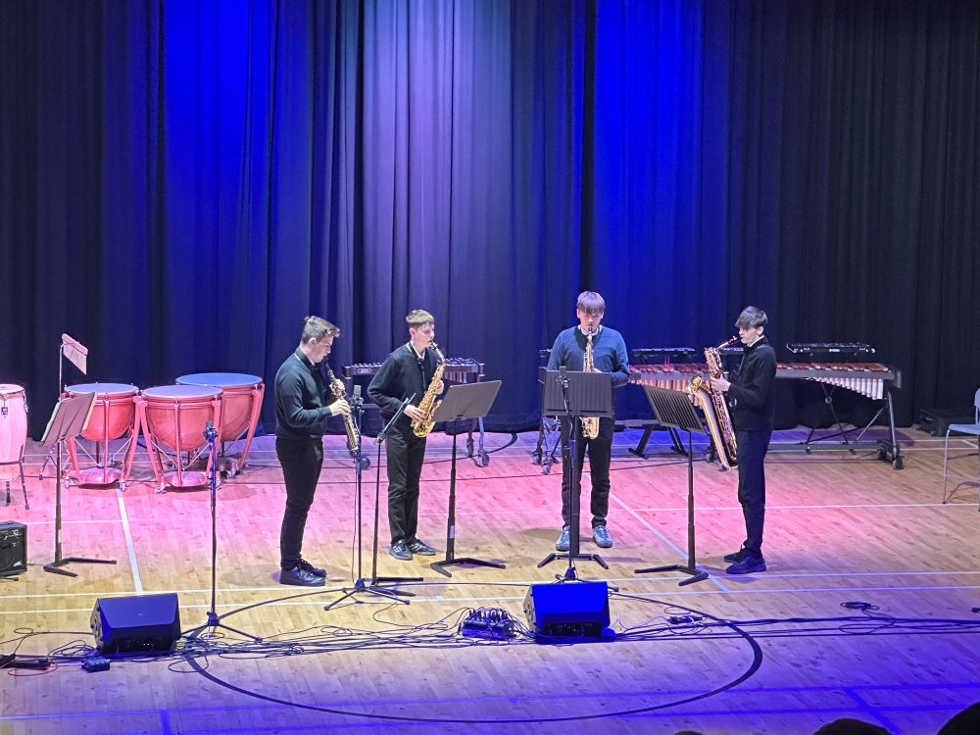
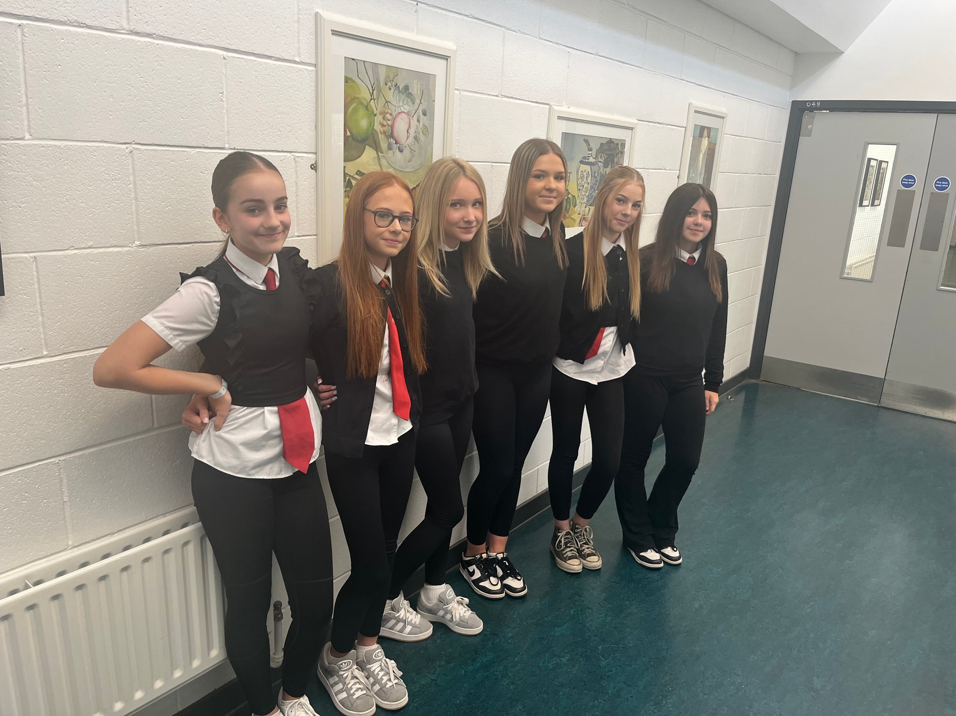
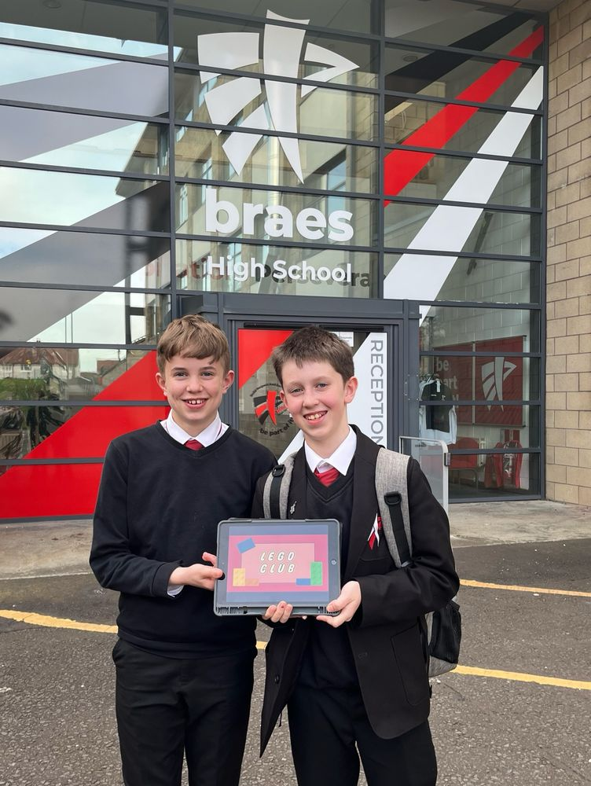
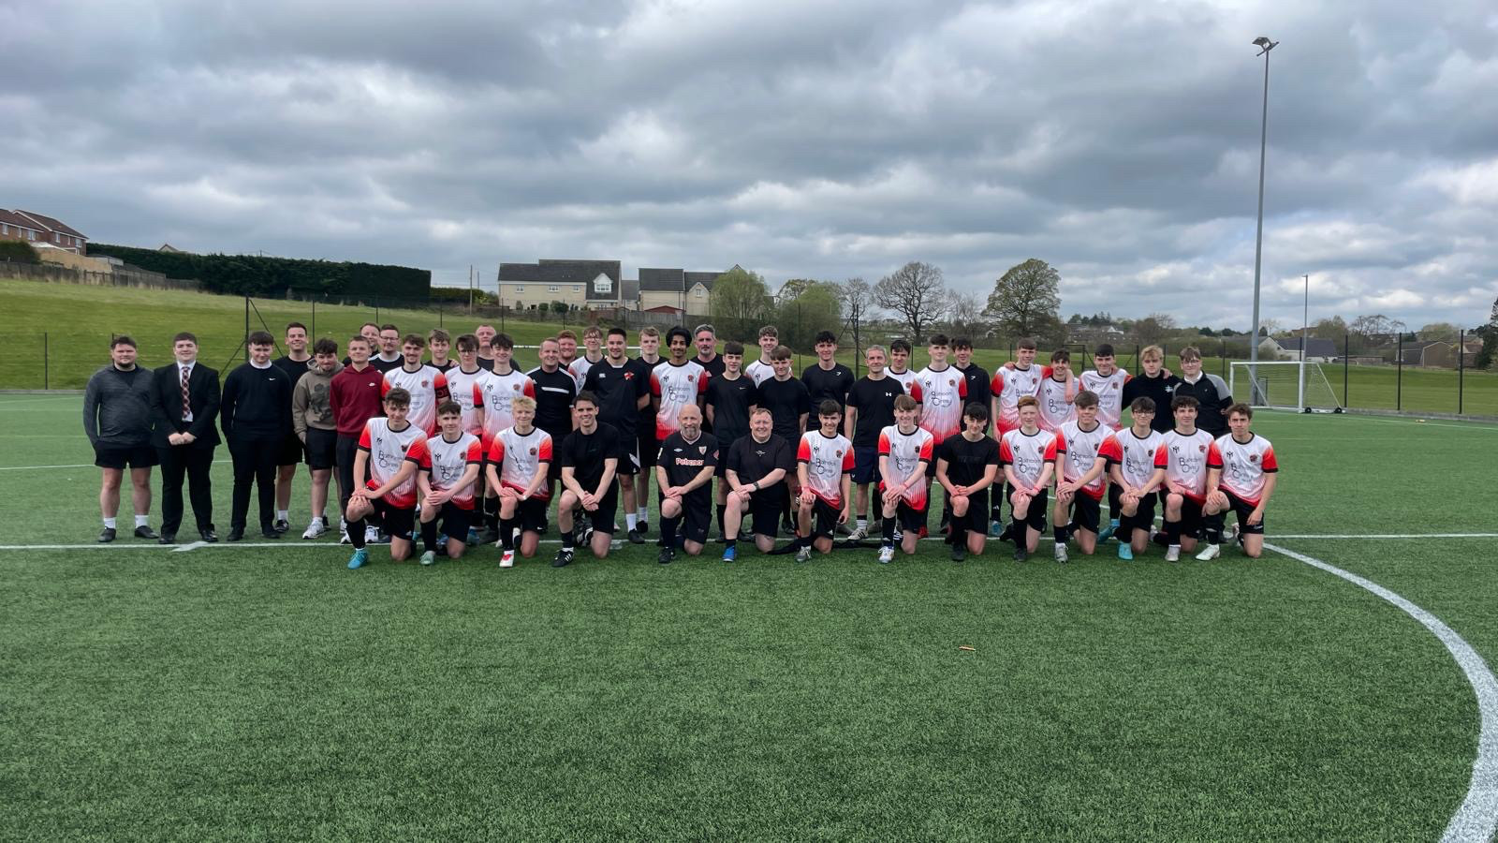
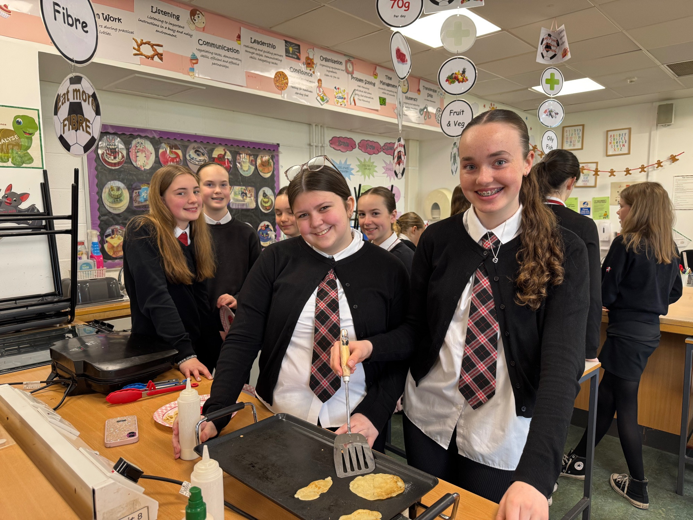
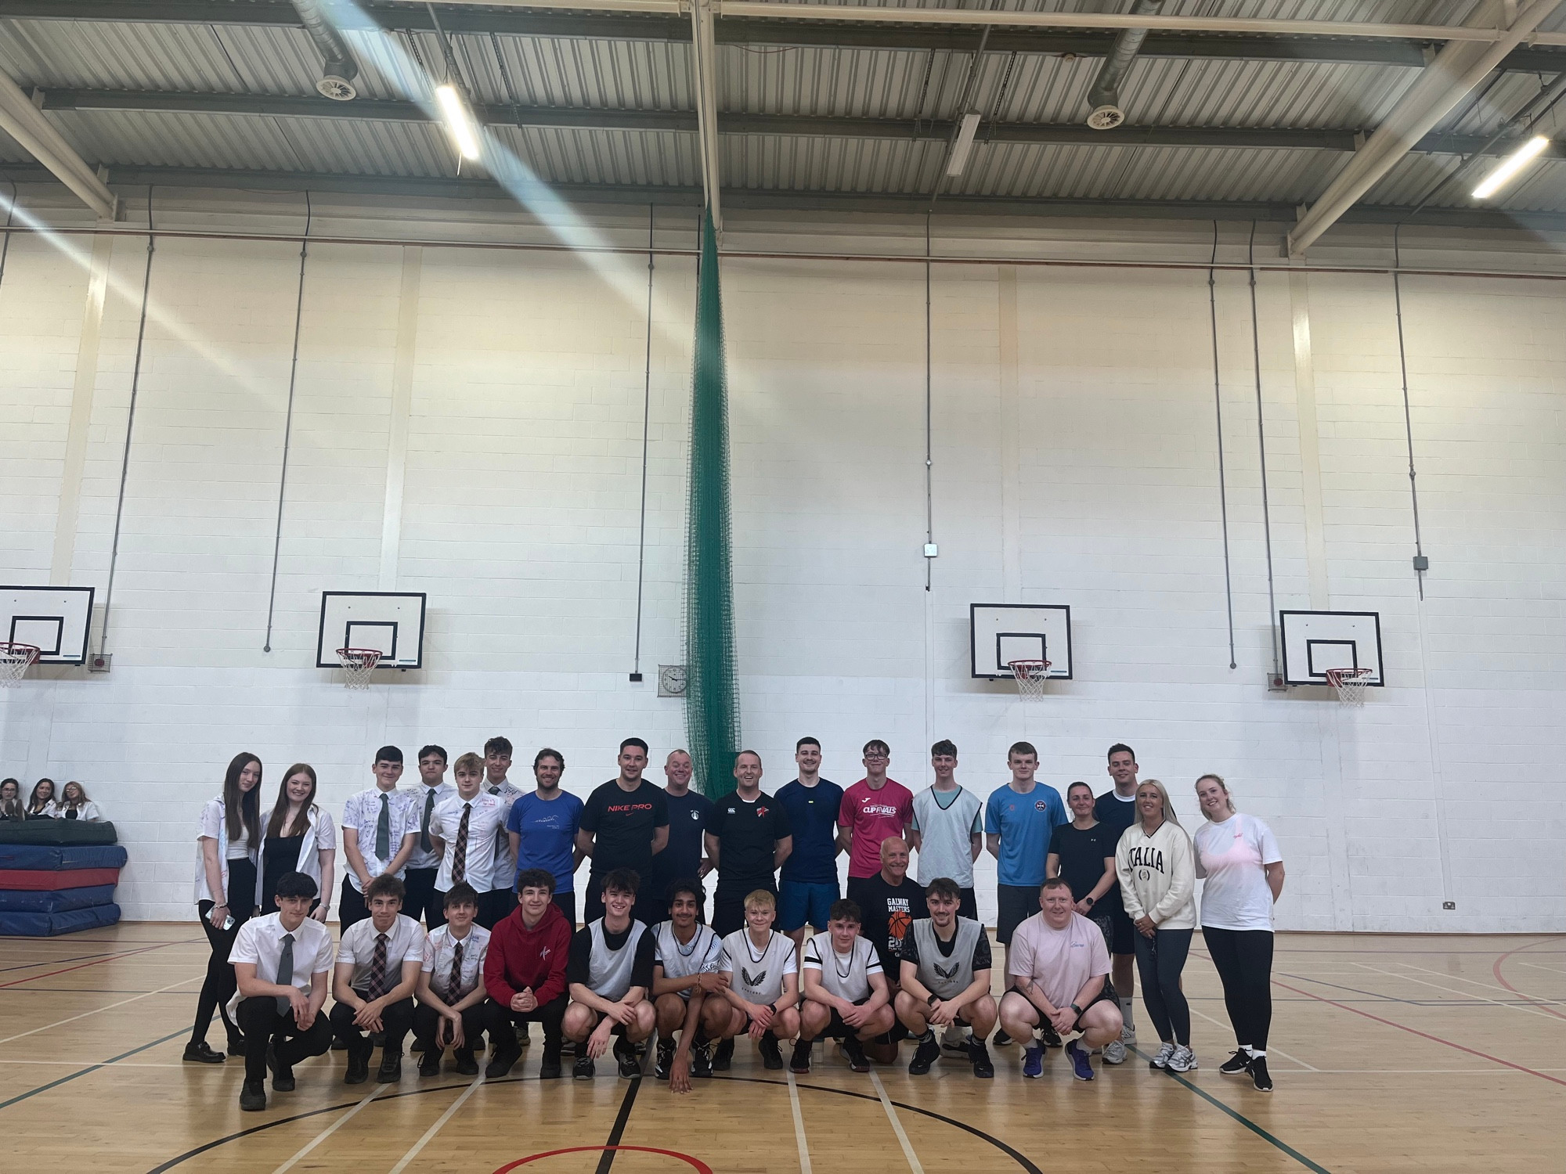



S2 Course Choice Process – Maximising Potential

Slide 2
How many courses do pupils in S3/4 study?
Year | Mandatory | Choice | Core
S3 | English (4 periods) Mathematics (5 periods) | 5 selected subjects (4 periods each) | PE PSE (3 periods in total)
S4 | English (5 periods) Mathematics (4 periods) | Continuation of 5 selected subjects above (4 periods each) | PE PSE (3 periods in total)

Slide 3
Understanding the Language of Levels
National 5/Level 5
National 4/Level 4
National 3/Level 3

Slide 4
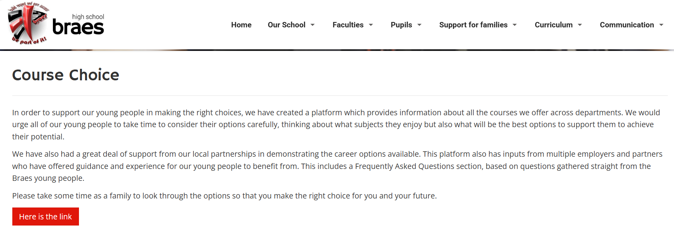
Course Information on our Website
Click Curriculum - Course Choice
Click Here is the link

Slide 5

Course Information on our Website
Click Subject Information

Slide 6
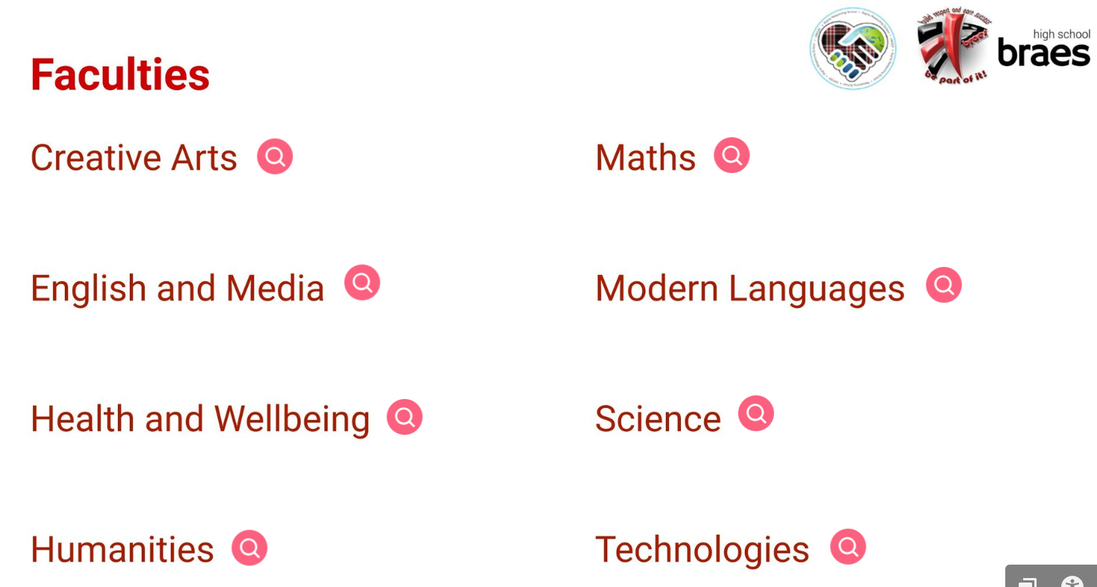
Course Information on our Website

Slide 7

Course Information on our Website
Course Outline
Assessment
Progression
Careers
Pupil Skills

Slide 8

What we have asked pupils to do: Seek Support and Advice
Consider:
What you think and know (what do you need?)
Support from home
Guidance from support staff, class teachers, Pastoral Heads, Faculty Heads, SLT, SDS
Use school website and other websites to support
Career and Course Choice Information Evening Wed 12th November
Complete course choice selection from 23rd February 2026 to 6th March 2026
Be Informed and Be Ambitious

Slide 9
Additional support online:
Braes High School – Braes High School | Braes High School | Secondary School Falkirk | Falkirk Education
College/University websites. UCAS - https://www.ucas.com/
Apprenticeships.Scot https://www.apprenticeships.scot/
PlanItPlus:https:www.planitplus.net
My World of Work: https://www.myworldofwork.co.uk/option-choices
Young Scot:
https://young.scot/get-informed/where-could-your-school-subjects-take-you
Be Informed and Be Ambitious

Slide 10
What we will do:
Career and Course Choice Information Evening
Classroom teacher/Faculty Head support
PSE lessons
One-to-one support from Grace Goodsir (SDS) grace.goodsir@sds.co.uk
One-to-one support from Pastoral Head
Communicate additional supports
Track 2 BGE Report Issued 18th December 2025
Be Informed and Be Ambitious

Slide 11


